Slide 1
Chapter 3: Cash Flow and Financial Planning
Assistant Lecturer:
[Asmaa Hamdy]

Slide 2
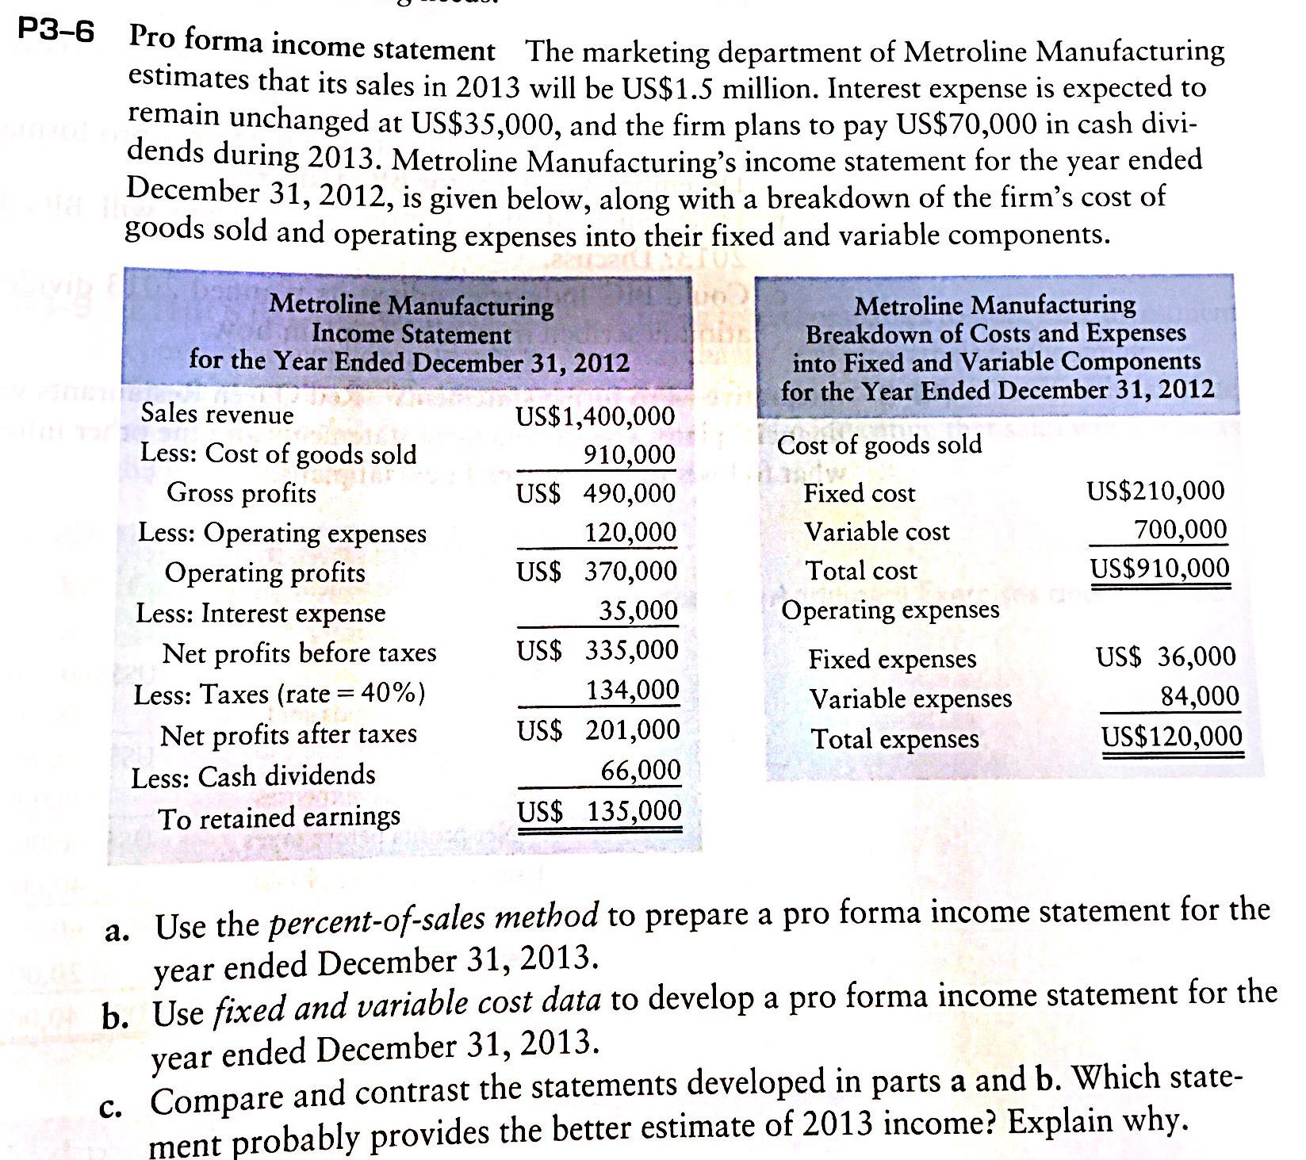

Slide 3
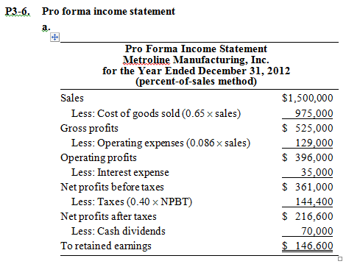

Slide 4
